Slide 1
Integrated Library
system
Presented by:-
Sunny Kumar
Roll ID-2001194
CSE

Slide 2
  Existing System
■ Fast report generation is not possible.
■ Tracing a book is difficult.
■ Information about issue and return of book is not properly maintained.
■ penalty is complex
■ Time manipulation
■ updating is tedious work

Slide 3
Introduction
• Integrated library system is all about organizing, managing the library and library-oriented tasks. It also involves maintaining the database of entering new books and the record of books that have been retrieved or issued, with their respective dates.
• The main aim of this project is providing an easy to handle and automated Integrated library system. This project also provides features and interface for maintaining librarian’s records, student’s history of issue and fines.
•T he owner can easily update, delete and insert data in the database with this project.The following are some of the features provided by this project

Slide 4
Objective
Basic objectives
■ More accuracy
■ speed improvement
■ data inconsistency
■ Better error handling
■ Integrity
■ The system will handle the maintenance of data
■ it handle entire transaction of book registration till issue of the book
■ books can be easily searched
■ The administerator details of books , authors and existing Member etc.
Other objectives

Slide 5
System requirements
Hardware requirements
■ Processor: intel i7,ideapad 330
■ RAM: 8 GB
■ Harddisk: 1500 GB
Software requirements
■ front end :- java eclipse
■ back end :- MySql
■ web server:- Xampp server

Slide 6
DFD
Library system
Admin
Student
Student list
login
Delete student
Register
Add book
List book
Login
Upd. Stud.
Update book
Renew book
Issue book
Search stud
Return book
List book
Search book
By book author
By name
By id
By book publish date
By book name
By book id

Slide 7
Advantages of application
■ This project can be used for any company, for infinite number of products, and for infinite number of categories as it is totally generic.
■ The data of the member would be entered in the database.
■ There would be a safe storage of information of the member in the database
■ quick,easy,flexible generation of the member reports
■ with the database any data can be added , modified, deleted very quickly
■ security features are very much provided in the system
■ user friendly environment

Slide 8
Software tools used
ECLIPSE
Eclipse is an integrated development environment (IDE) used in computer programming. It contains a base workspace and an extensible plug-in system for customizing the environment. ... The Eclipse software development kit (SDK), which includes the Java development tools, is meant for Java developers.
• The Java Development Tools (JDT) project provides a plug-in that allows Eclipse to be used as a Java IDE, PyDev is a plugin that allows Eclipse to be used as a Python IDE, C/C++ Development Tools (CDT) is a plug-in that allows Eclipse to be used for developing application using C/C++, the Eclipse Scala plug-in allows Eclipse to be used an IDE to develop Scala applications and PHPeclipse is a plug-in to eclipse that provides complete development tool for PHP.

Slide 9
SWING
Swing in Java is a lightweight GUI toolkit which has a wide variety of widgets for building optimized window based applications. It is a part of the JFC( Java Foundation Classes). It is build on top of the AWT API and entirely written in java. It is platform independent unlike AWT and has lightweight components.
It becomes easier to build applications since we already have GUI components like button, checkbox etc. This is helpful because we do not have to start from the scratch.

Slide 10
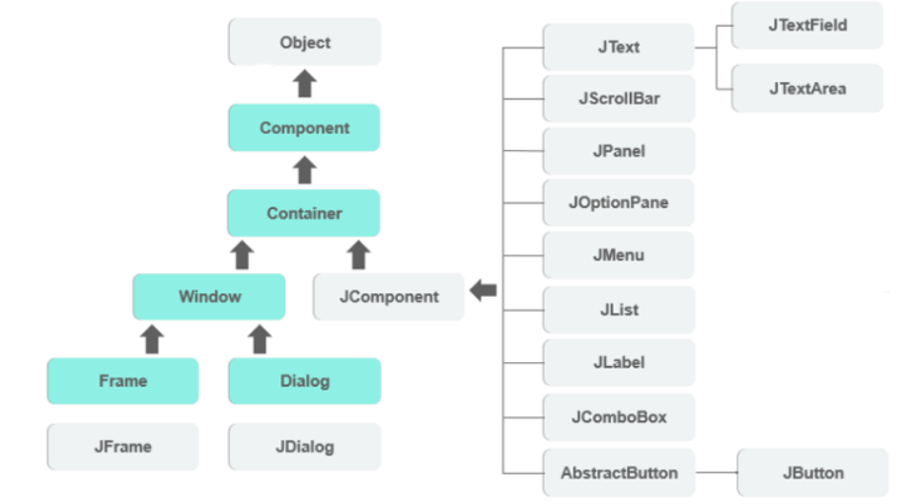
JAVA SWING HIERACHIE

Slide 11
MYSQL
MySQL is a database management system.
MySQL databases are relational.
MySQL software is Open Source.
The MySQL Database Server is very fast, reliable, scalable, and easy to use.
MySQL Server works in client/server or embedded systems.
A large amount of contributed MySQL software is available.

Slide 12
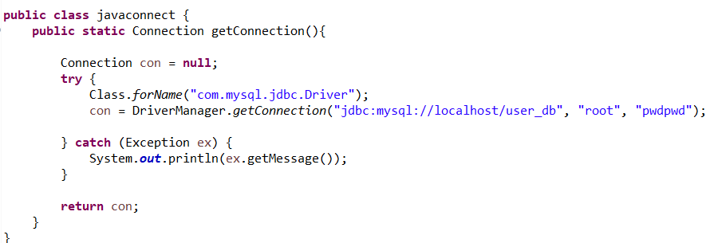
JDBC CONNECTIVITY
JDBC stands for Java Database Connectivity. JDBC is a Java API to connect and execute the query with the database. It is a part of JavaSE (Java Standard Edition). JDBC API uses JDBC drivers to connect with the database.
• We can use JDBC API to access tabular data stored in any relational database. By the help of JDBC API, we can save, update, delete and fetch data from the database. It is like Open Database Connectivity (ODBC) provided by Microsoft.
Steps of jdbc
Loading the Driver
Create the connections
Create a statement
Execute the query
Close the connections

Slide 13
Snapshots of
forms and tabes

Slide 14
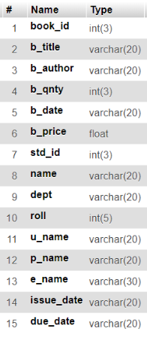
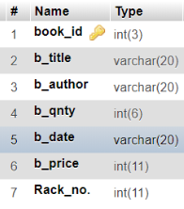
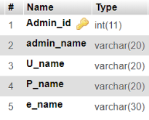
Tables
Table name:
add_book
Admin_reg
ISSUE

Slide 15
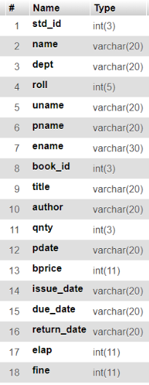
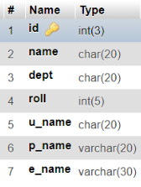
Table name:-
Return_db
User_reg

Slide 16
Snapshots

Slide 17
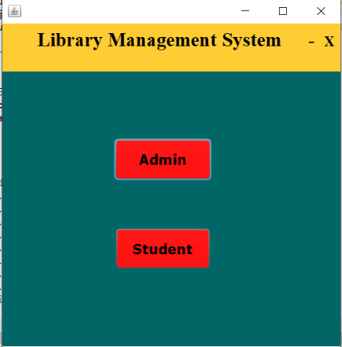
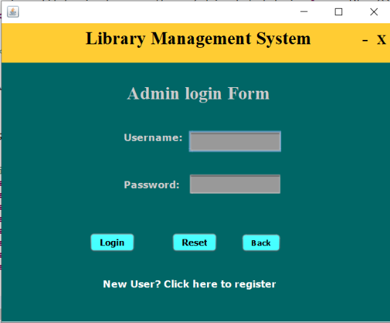
Modules
Admin login form

Slide 18
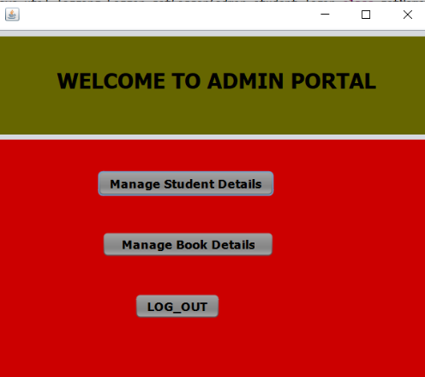
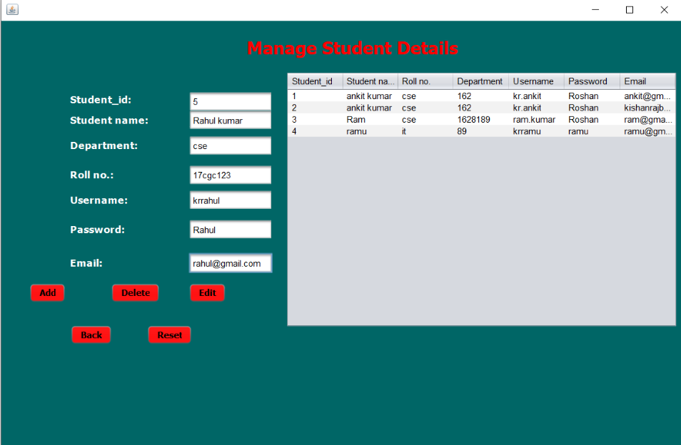

Slide 19
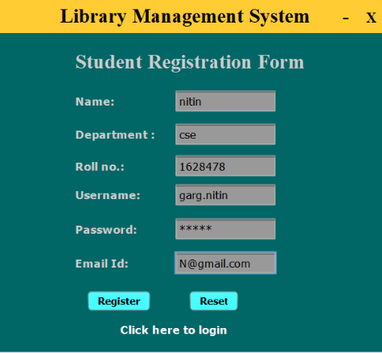
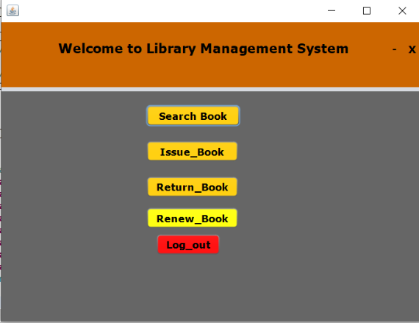
Student registration form

Slide 20
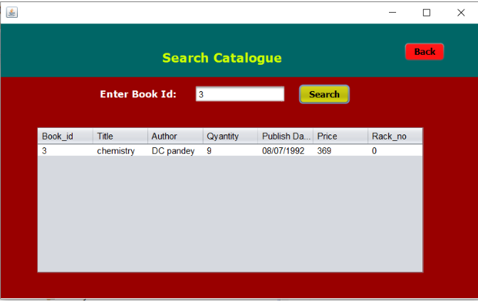
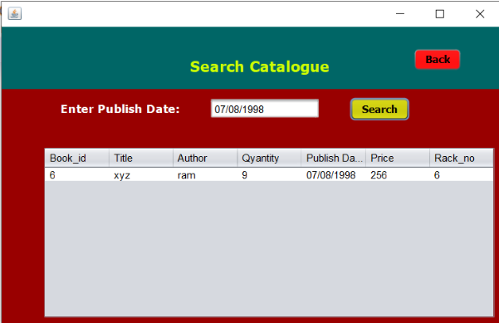
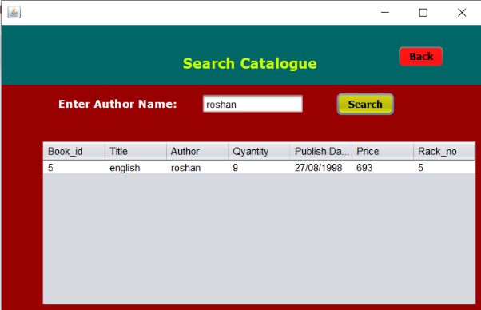
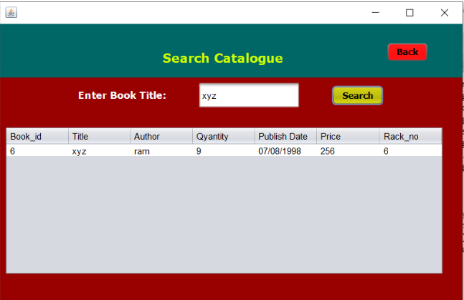
Search book by book id,publish datebook ,author and book title

Slide 21
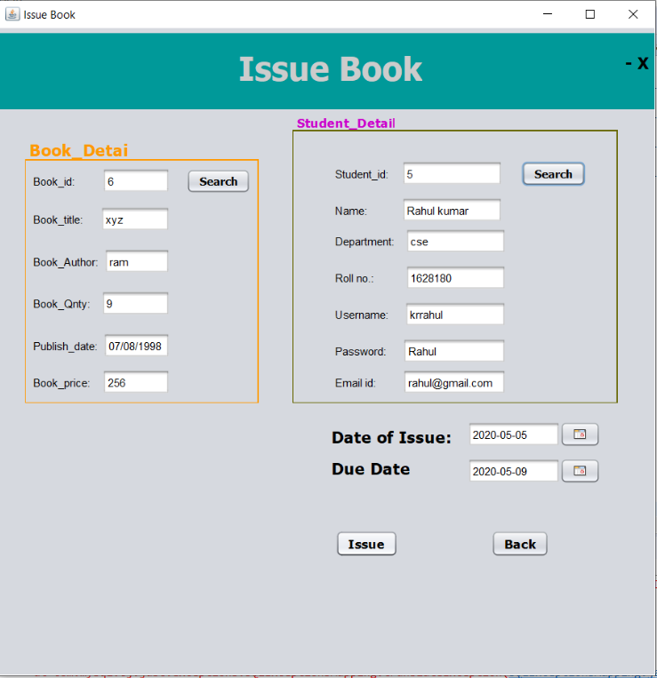
Issue book

Slide 22
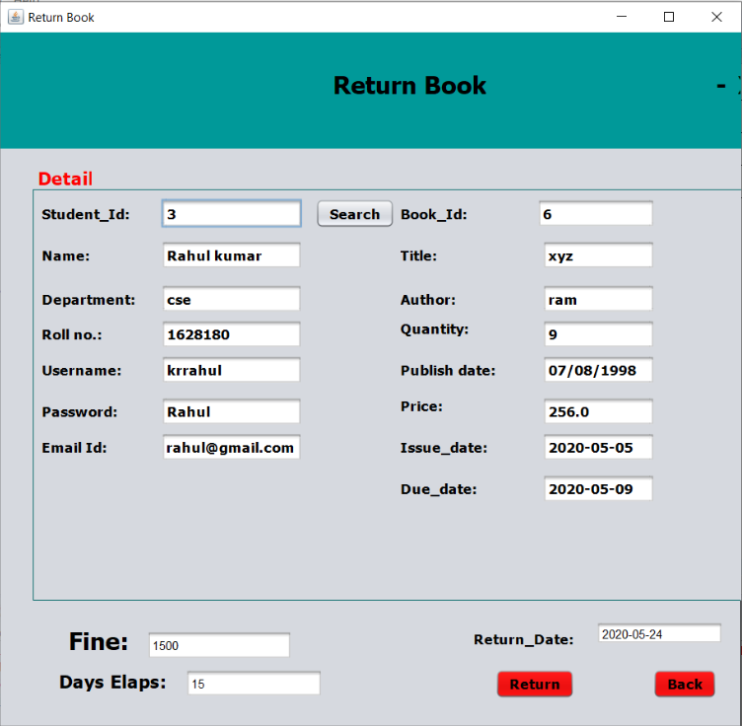
Return book

Slide 23
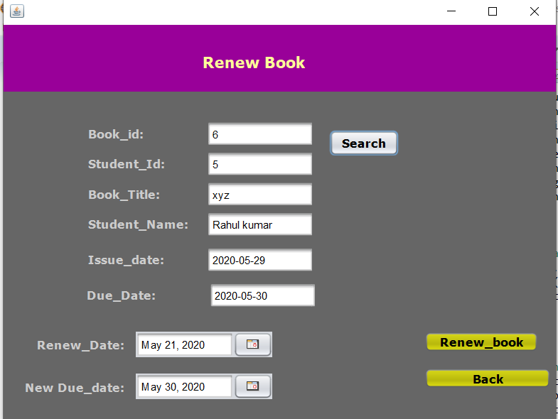
Renew book

Slide 24
Scope for future Enhancement
• It is not possible to develop a system that makes all the requirements of the user. User requirements keep changing as the system is being used .Some of the future enhancements that can be done to this systems are:
• As the technology emerges ,it is possible to upgrade the system and can be adaptable to desired environment.
• Based on the future security issues, Security can be improved using emerging technologies.
Sub admin module can be added.

Slide 25
conclusions
■ The project Library management system is for computerizing the working of library.
■ The Library Management system allows the user to store the book details and the person’s details.
■ This software allows storing the details iof all the data related to library.
■ The implementation of the system will reduce data entry time and provide readily calculated reports.

Slide 26
Thank you

